Slide 1
Knee Mounted rehabilitation Solution
James Dickson

Slide 2
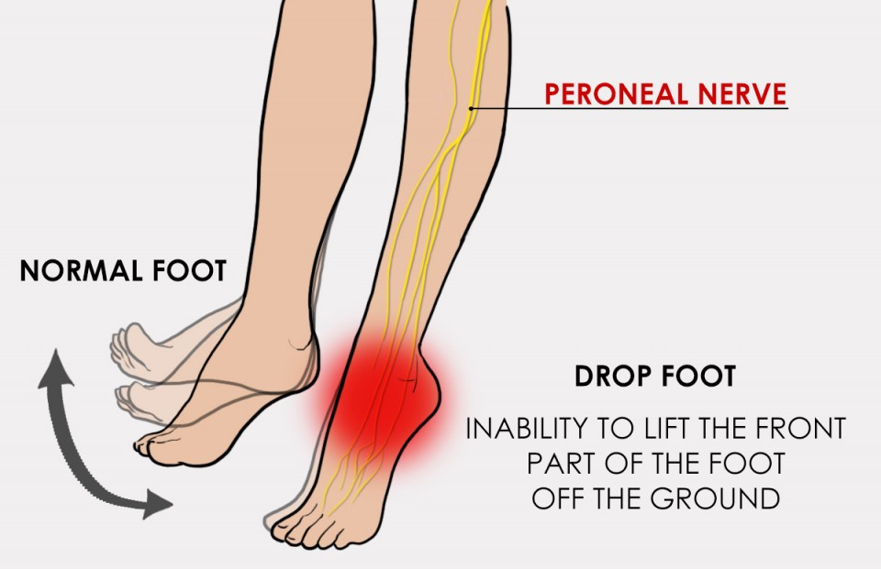
What is foot Drop?
Cannot lift the front of the foot
Can lead to falls
Caused by:
-Nerve Injury
-Brain disorders
-Spinal Disorders
-Muscular Disorders
https://www.bodyorganics.com.au/pilates-strategies-foot-drop/

Slide 3
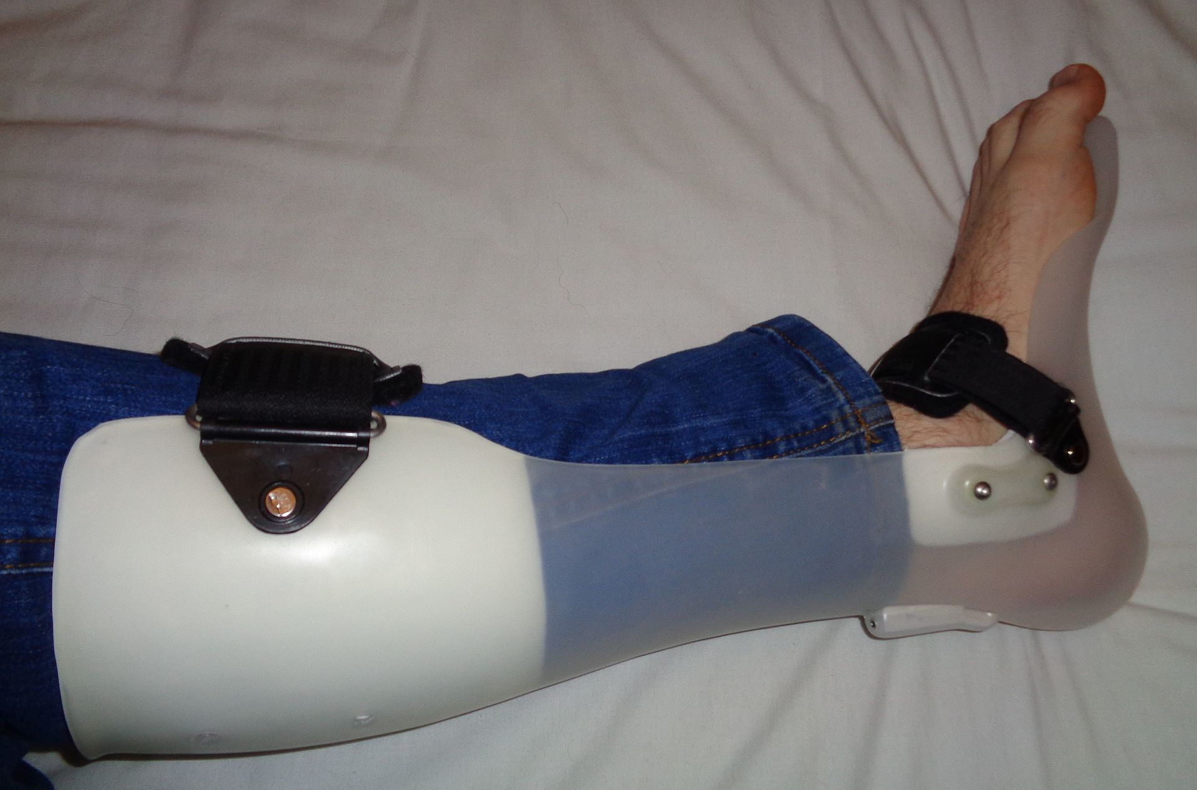
Treatments for foot Drop
physiotherapy – to strengthen your foot, ankle and lower leg muscles
wearing an ankle-foot orthosis
electrical nerve stimulation – can help lift the foot
surgery – an operation to fuse the ankle or foot bones
in severe or long-term cases
https://en.wikipedia.org/wiki/Foot_drop#/media/File:AFO_brace_for_foot_drop.JPG

Slide 4
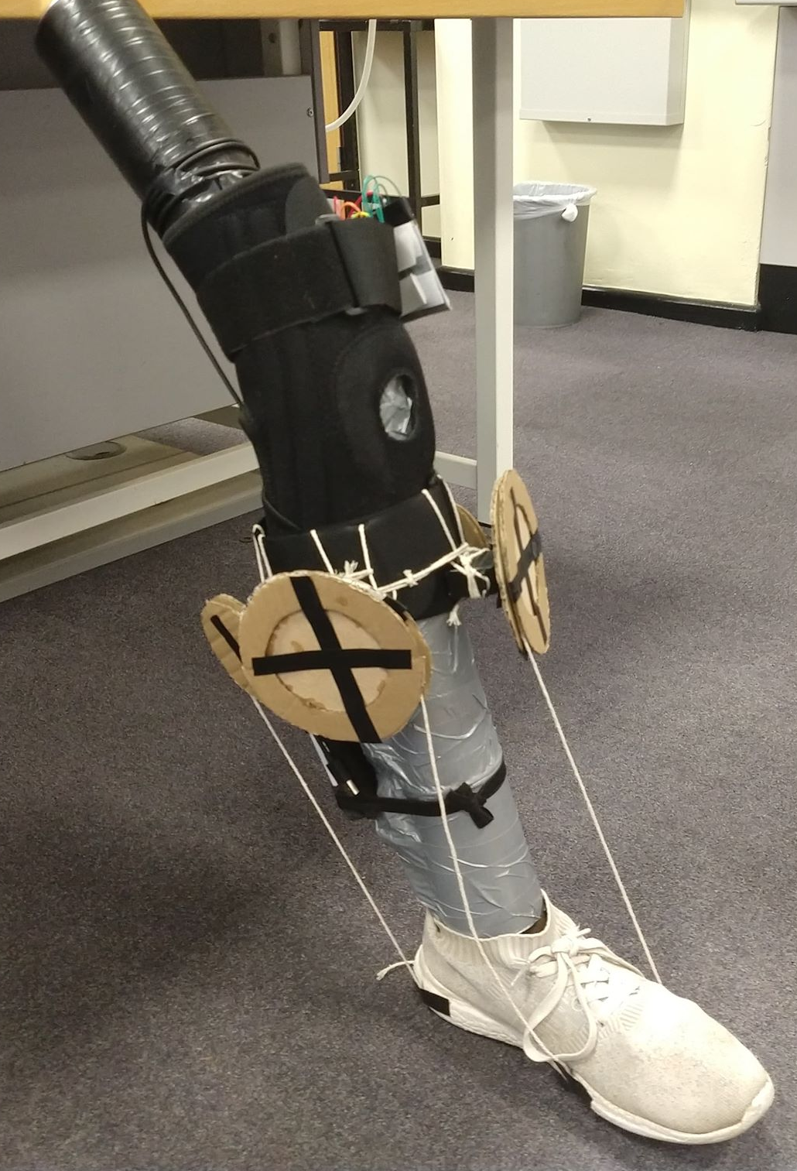
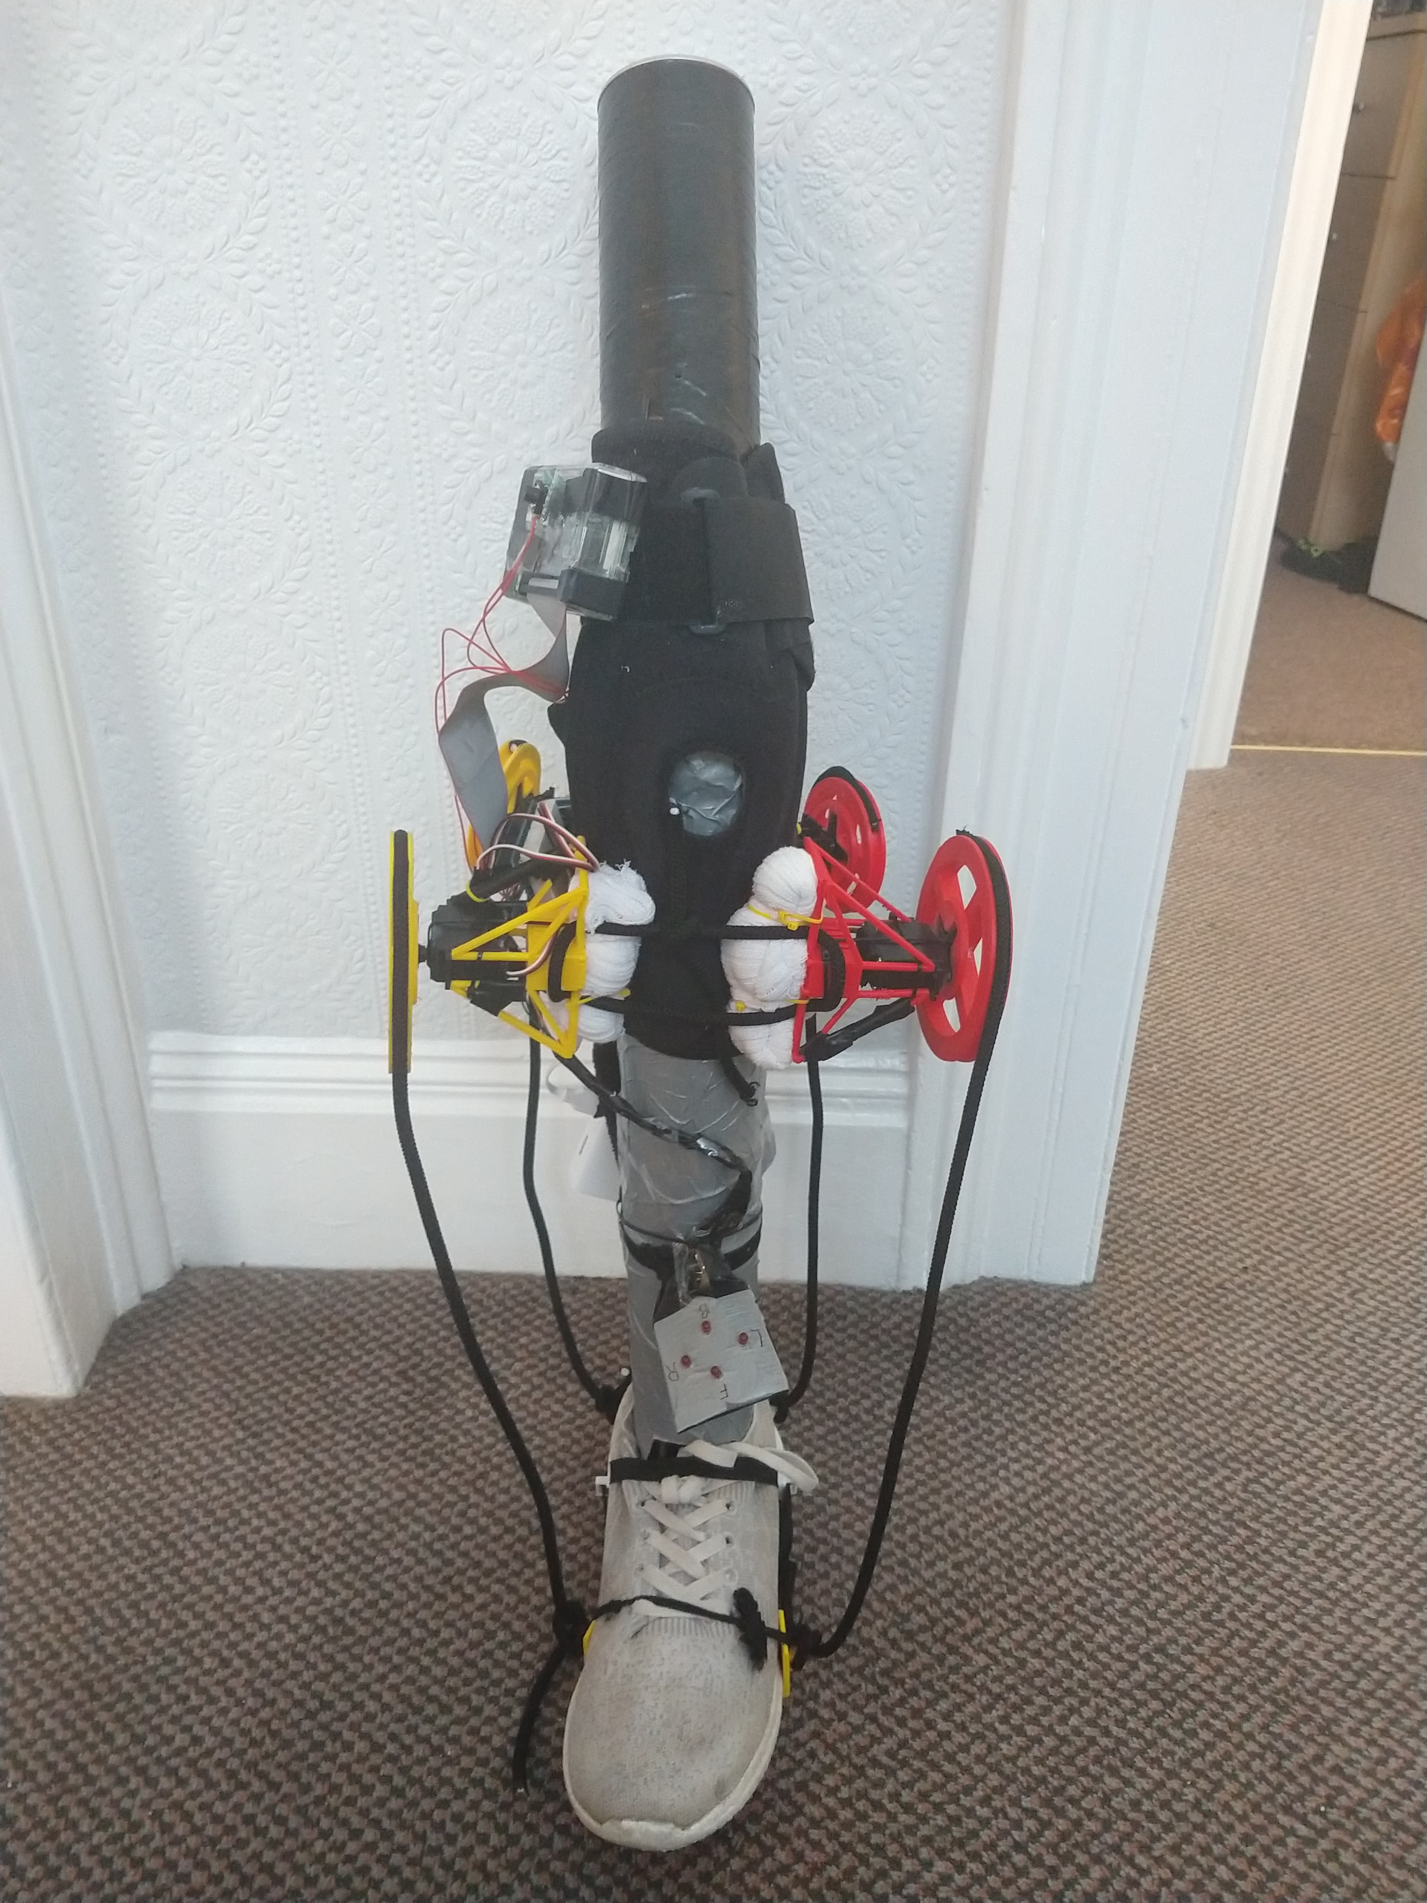
Where this project comes in
This is a soft robotic solution
Tested on a custom leg
Aims to provide increased rehabilitation potential
Relative low cost
Must be customisable for multiple patients
From this to this…

Slide 5
What does this system consist of?
Two Modes of operation
4 directional movement programming
4 motors working in tandem
A Gyroscopic sensor
An LED Feedback system
Easily length customisable tendons

Slide 6
What are the benefits to this project?
Provides an easy to follow rehabilitation program
Can be made easily available
Inexpensive form of treatment
Gives instant feedback to the patient
Easy foot mount to avoid intrusion

Slide 7
How could this project be expanded?
Gather an increased amount of data
Decrease size
Reduce weight
Allow for long distance feedback
Reduce cost

